Slide 1
A b o u t U s
Company Profile
(updated on May. 11, 2023)

Slide 2
Introduction
NAME OF COMPANY : L&S Textile Co., Ltd.
LOGO : ‘L’ me L - Light of the world
S - Salt of the earth
ADDRESS : Room #303, Haedong Bldg.,
12 Baekjegobun-ro 50-gil,
Songpa-gu, Seoul 05630, Korea
TELEPHONE NO : 822-448-5574/3
FAX NO : 822-408-5574
CONTACT PERSON : Paul Kim / President (Paulkim@Lnstextile.com) Rachel Lee / R&D Marketing Director (Rachel@Lnstextile.com)
Jason Lee / Sales Director (Jasonlee@Lnstextile.com)

Slide 3
Organization
Representative (Paul Kim)
ADMIN
(JR Lim)
Business-1
(Jason Lee)
Business-2
(Mary Lee)
Fabric R&D
Marketing
(Rachel Lee)
Print Develop
(Sonia Moon)

Slide 4
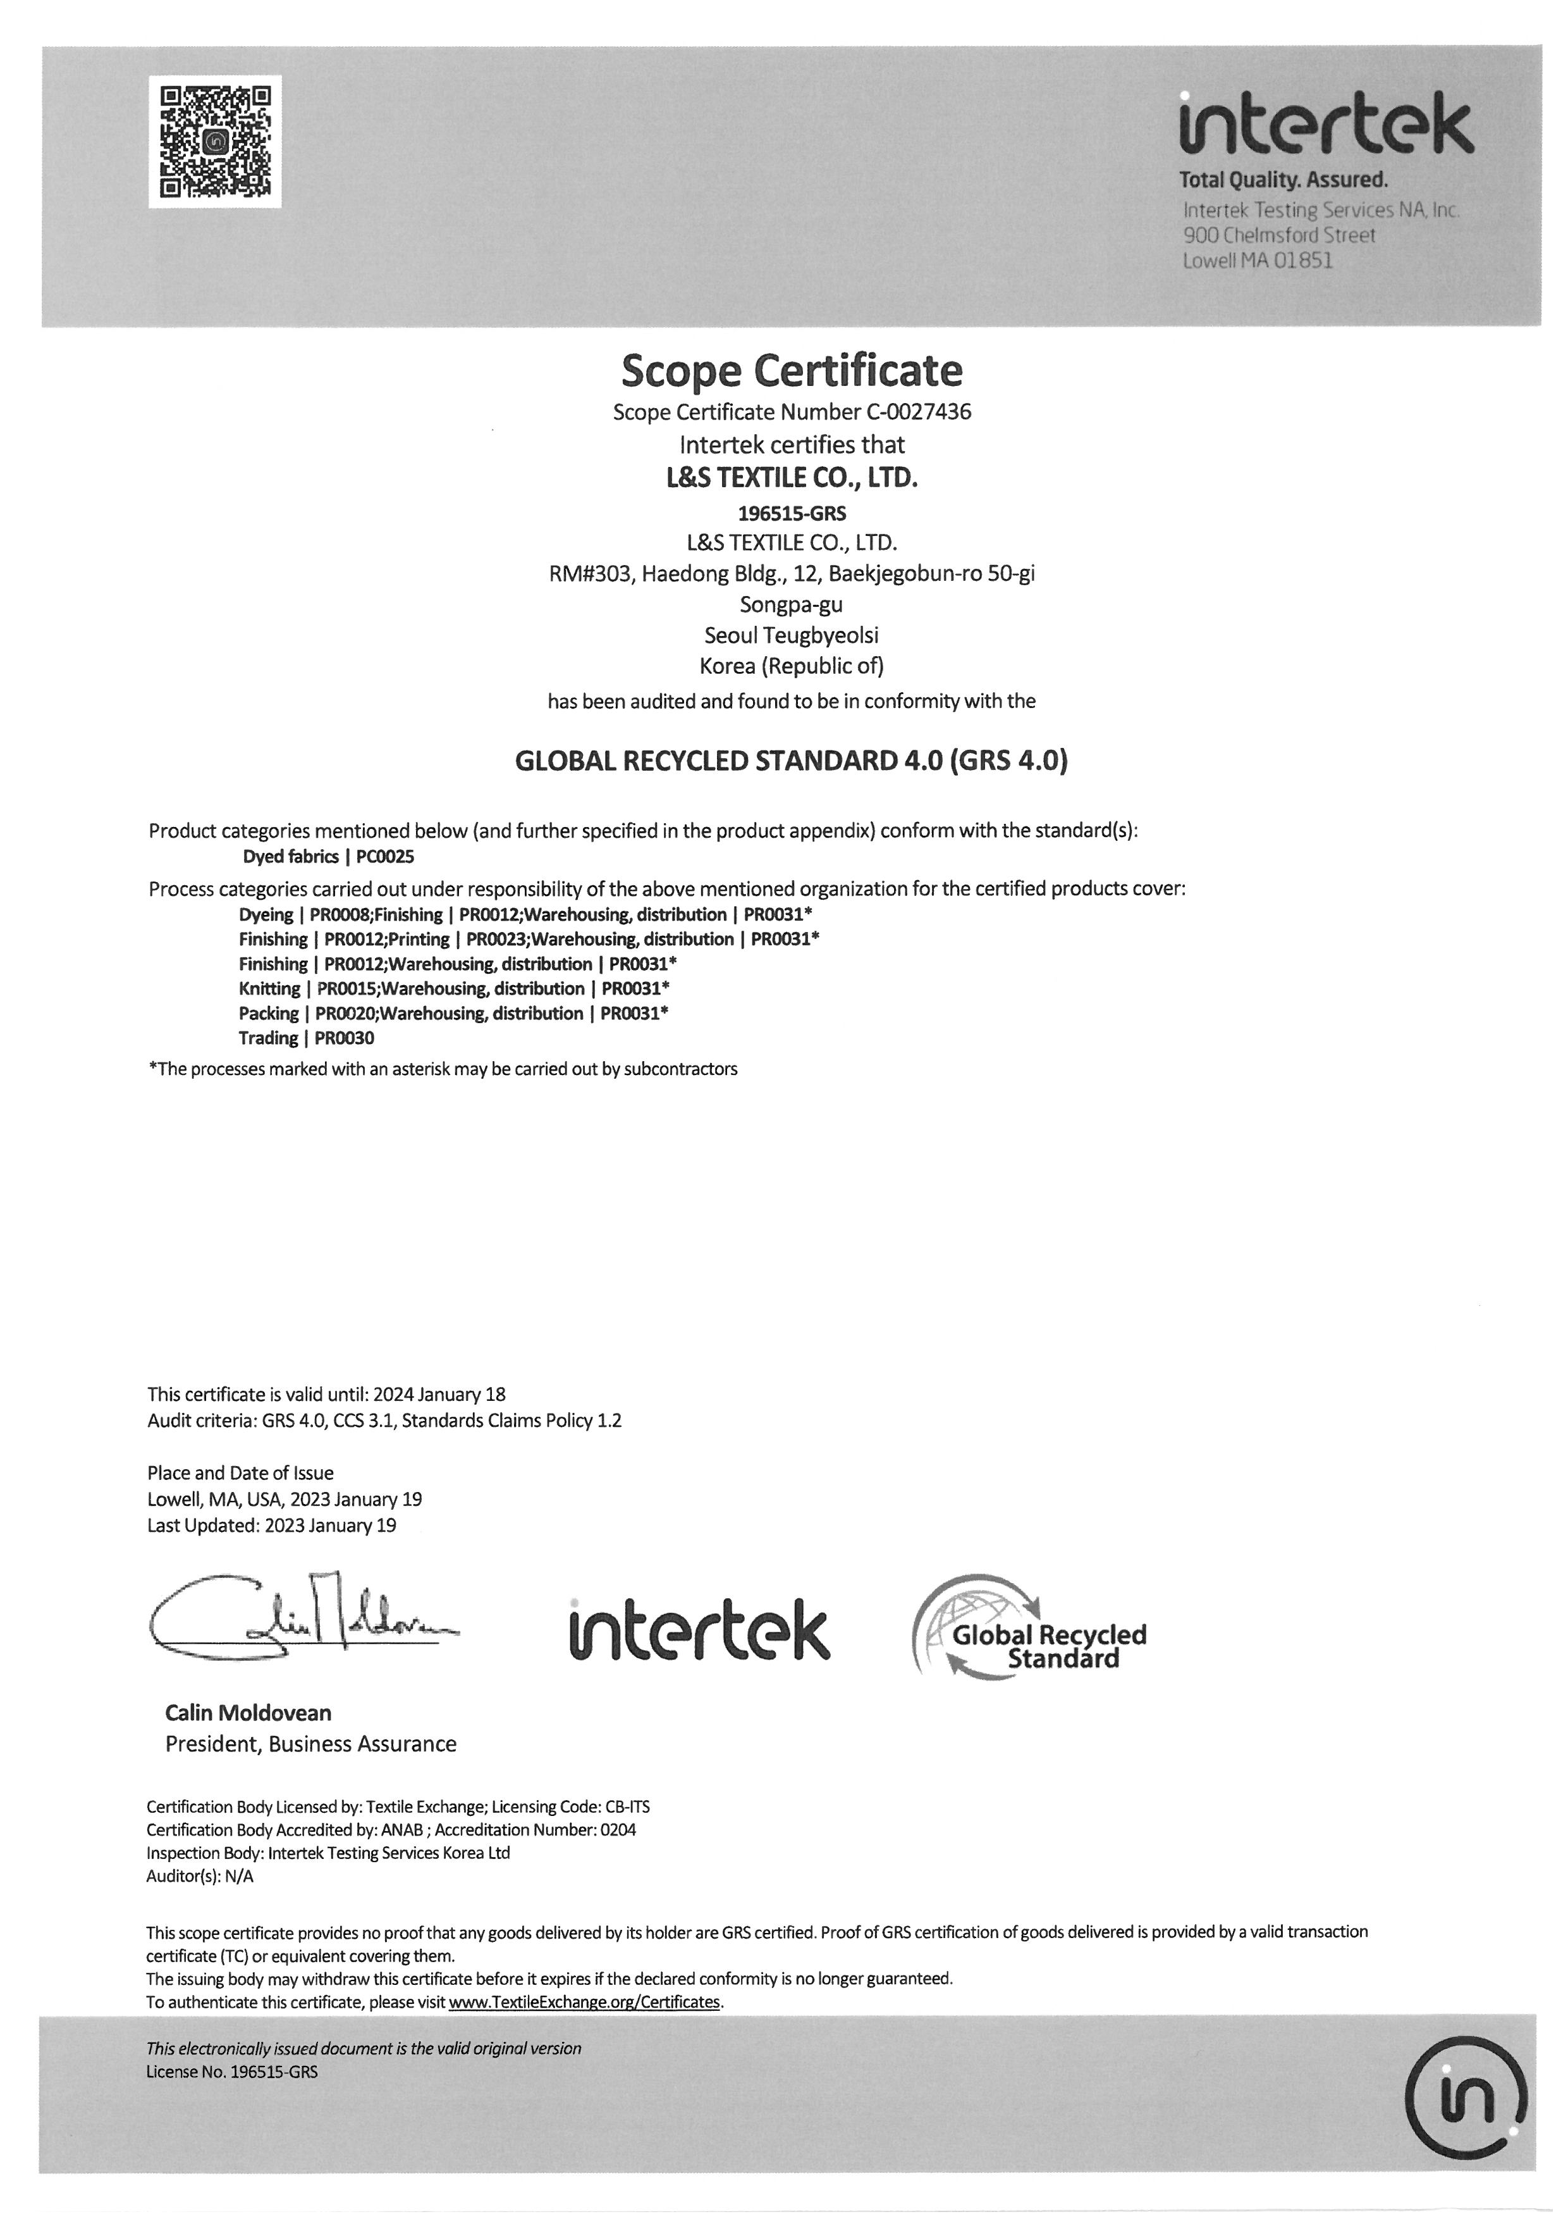
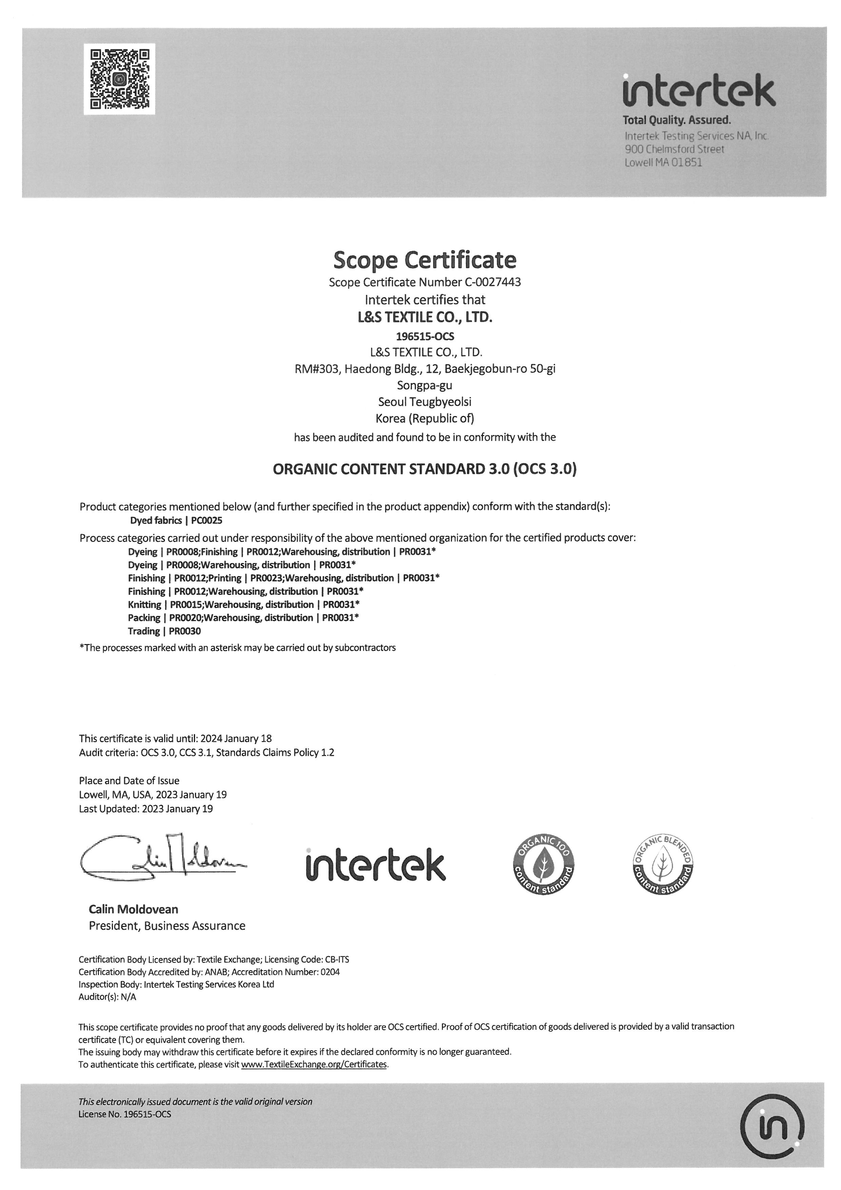
Strength & Specialty
Fabric Development-Focused
Seasonal Own Development
Direct Development with Customer
Collaboration with Vendors
Print Development
Technical Support
Less Consumption-Costing related
Sustainability Initiative
GRS/OCS/HIGG Index/USCTP
& Supima License

Slide 5
Major Customers

Slide 6
Products
All kinds of Circular Knits
Single Jersey
- Single Plain
- Lacoste-Pique
- French Terry
Double Jersey
- Rib, Waffle, Drop Needle
- Interlock, Mesh
- Ponte
Jacquard (Single, Double)
- Eyelet, Pointelle
- Engineer Stripe
- Full Jacquard
Others
- Loop Terry, Fleece
- Velour
- Various textured Knits
Cotton Cotton blended
Compact cotton
Supima cotton
Organic cotton
Rayon / Modal/ Tencel
Rayon, Ecovero
Modal, Ecoclean
Tencel Lyocell
Bamboo
Wool Cotton wool
Rayon wool
Acrylic wool
Linen Linen/Cotton
Linen/Polyeseter
Linen/Rayon
Polyester Polyester blended
Micro polyester
Recycle polyester
Nylon blended

Slide 7
Monthly production capacity per production unit (In South Korea)
1. Knitting capacity (Kg)
 | factory | factory capa | capa for L&S | remark
1 | Bobae | 200,000 | 200,000 | single machine
2 | NSC | 230,000 | 100,000 | single machine
3 | Sambo | 300,000 | 100,000 | double/rib/waffle machine
4 | Korea | 150,000 | 70,000 | loop terry machine
5 | Haedong | 400,000 | 80,000 | low gg, jaquard machine
total |  | 1,280,000 | 550,000
2. Dyeing capacity (Kg)
 | factory | factory capa | capa for L&S | remark
1 | YH Trading | 600,000 | 200,000 | cotton, rayon, modal, poly
2 | Ilshin | 1,000,000 | 200,000 | cotton, rayon, poly
3 | Dongju | 400,000 | 50,000 | Cotton, tencel, modal, poly
4 | DYETECH | 500,000 | 100,000 | cotton, rayon, poly
total |  | 2,500,000 | 550,000
3.Printing capacity (Yd)
 | factory | factory capa | capa for L&S | remark
1 | Donghwan | 3,500,000 | 350,000 | flat bed, rotary, digital print (cttn/rayon/nylon) ,DTP
2 | Hyupsung | 2,500,000 | 250,000 | flat bed, rotary, rollerl print (cttn/rayon/poly)
total |  | 6,000,000 | 600,000
4.Finishing capacity (Kg)
 | factory | factory capa | capa for L&S | remark
1 | Sunil | 1,500,000 | 300,000 | brush, shearing, PFP soaping, stenter, spray wash
2 | Jesang | 1,000,000 | 150,000 | PFP, soaping, stenter, spray wash
3 | Samsung | 1,000,000 | 100,000 | brush, shearing, PFP soaping, stenter, spray wash
4 | Hankook | 700,000 | 100,000 | pigment wash, bio washing, softner wash
total |  | 4,200,000 | 650,000

